Slide 1

Brandhall Primary School Reading Workshop 27.09.24

Slide 2
Aims
National Curriculum
What do we do here at Brandhall?
Why is it important?
What do the professionals say?
What do we do at Brandhall?
How do I get my child to read?
Resources

Slide 3
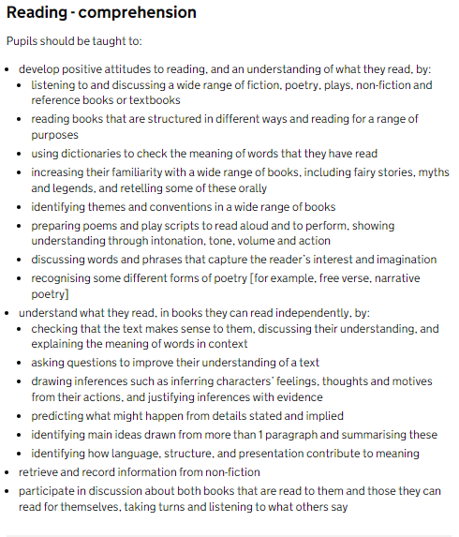
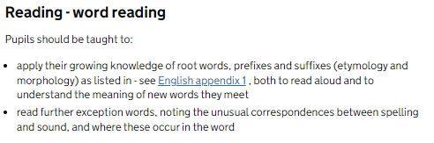
National Curriculum
National Curriculum
Word reading
Comprehension

Slide 4
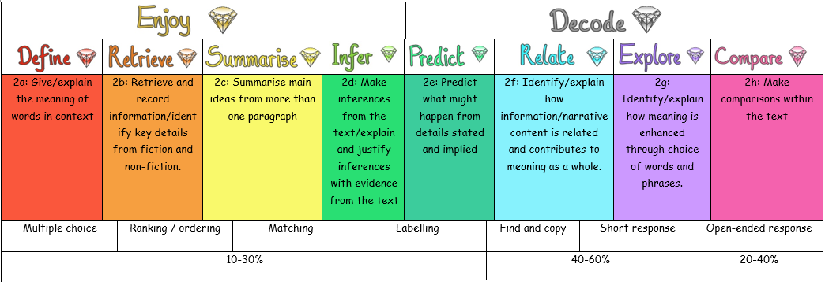
What do we do at Brandhall?
Reading Gems

Slide 5



Why is reading important?
Cognitive development
Empathy
Gaining deeper understanding
Building stronger relationships
Improved literary skills
More extensive vocabulary
Greater concentration

Slide 6
What do the professionals say?
Their vocabulary is larger and more extensive.
They perform better academically.
Their imagination can run wild.
Their creativity skills develop.
They develop empathy.
They gain a deeper understanding of their world.
Their concentration levels improve.
The parent and child bond improves.
Their cognitive development is supported.
Their social skills and interaction improve

Slide 7
What do we do at Brandhall?
Salford – as and when needed
NTS Reading Test – 3 times a year
Weekly whole class reading sessions (Gems/LW)
Comprehension sessions
1:1 reading with children
3x week minimum reading for pleasure sessions
Curiosity approach and rotation of books.
Word of the week for language acquisition
Dictionary/Thesaurus work within English lessons
High quality texts for every English unit.

Slide 8
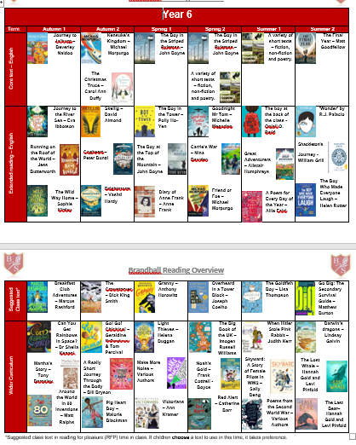
What do we do at Brandhall?

Slide 9
How do I get my child to read
at least three times a week?
Start off with something they enjoy
Use yourself as an example – reading out
Make it part of the routine
Talk about the books they’ve read.
Different genres
Re-read their favourite book
Limit distractions
Read yourself!

Slide 10


Resources
Levelled reading book
School Library book
Class reading book (in school)
Public libraries
Kindle
Audible
YouTube
Webpages, newspapers, etc.

Slide 11
Bug Club/Serial Mash
Chance to read online – not just decoding!
Lots of comprehension.
Shares results with class teachers – book bands.
Auto progress
School code – r7t6
Logins
Why BugClub?
Serial Mash – choice – online, lots of examples of non-fiction. Activities!

Slide 12
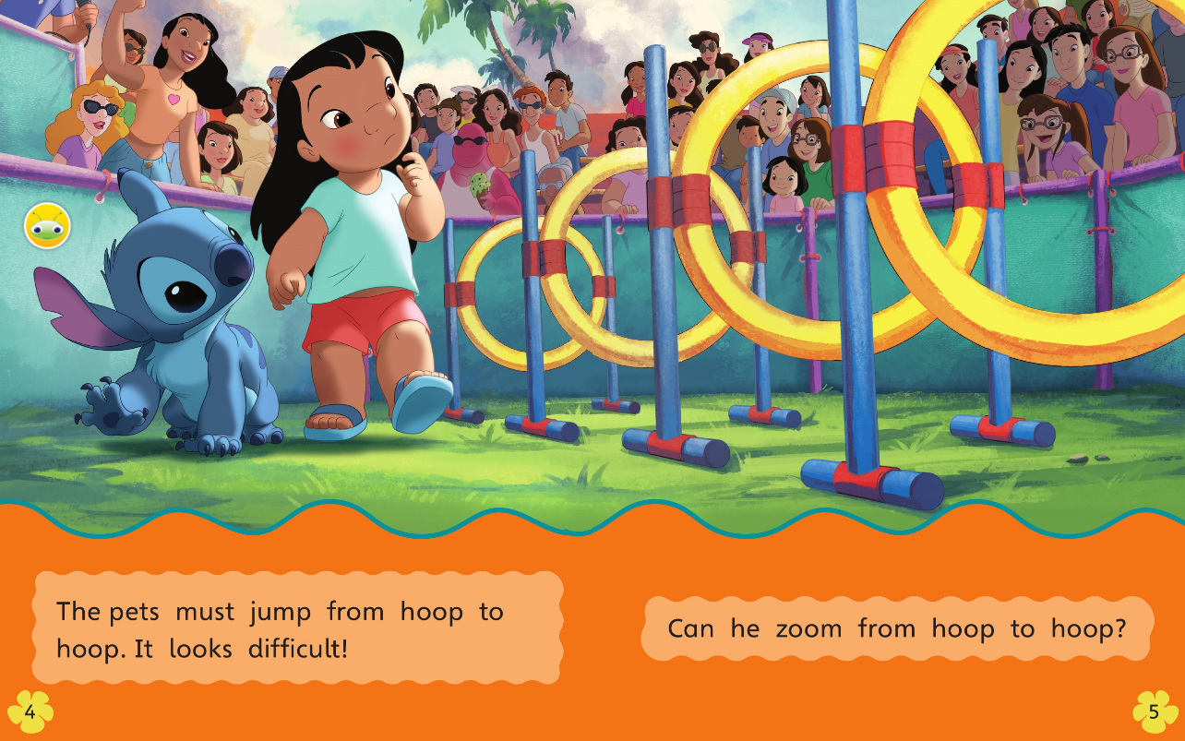
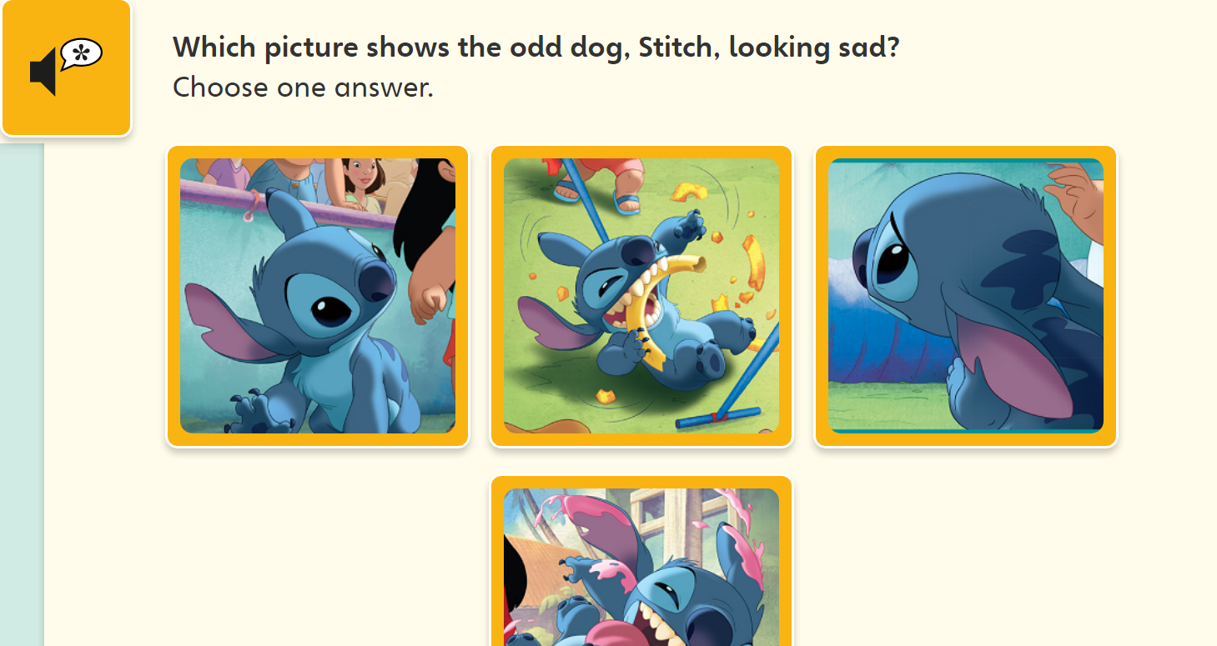
Bug Club

Slide 13
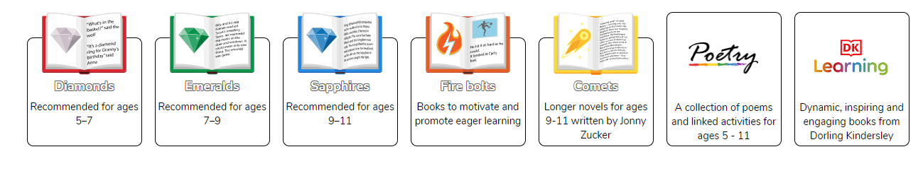
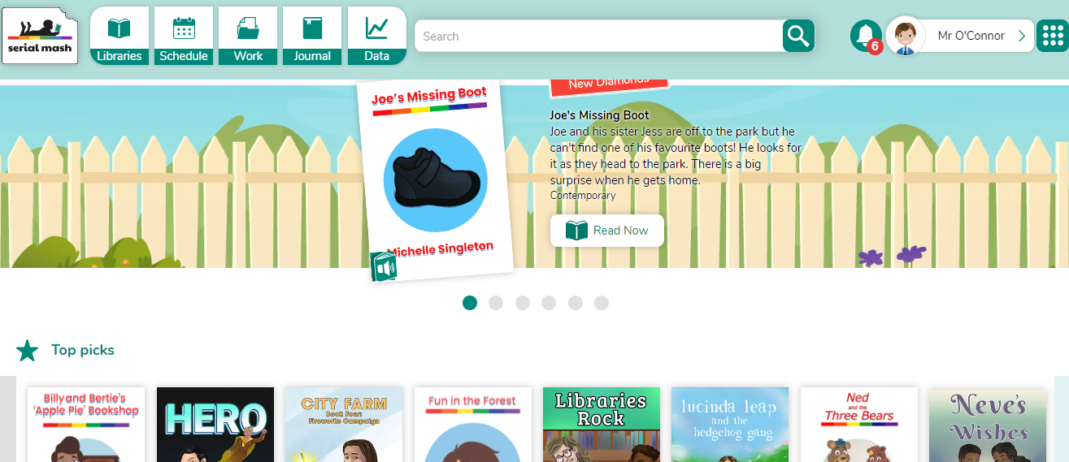
Serial Mash

Slide 14
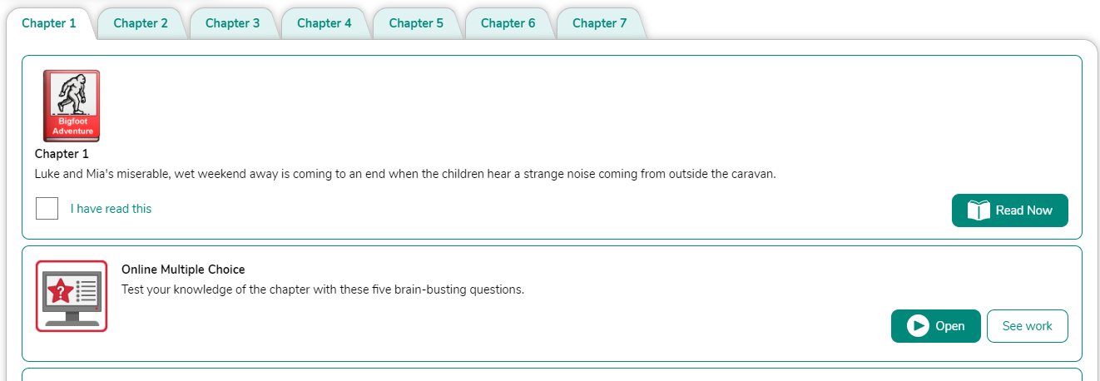
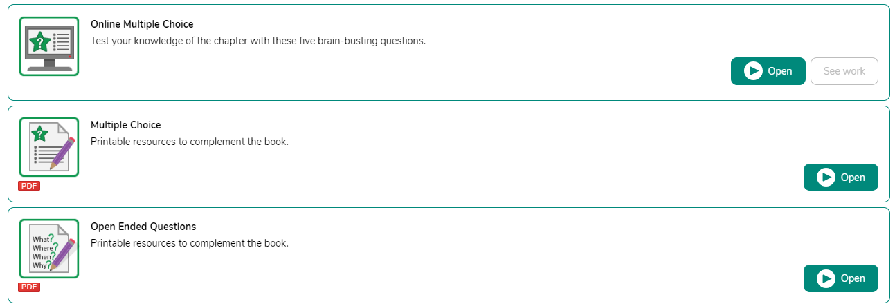
Serial Mash

Slide 15
Any questions?
Feel free to stay behind and ask after

